Slide 1
Image Caption Generation
Attention Model vs Transfomers
Hanish Bhogadi

Slide 2
Goal
Image Captioning refers to define the context of the image in text form
In Data Science, Image Captioning is a problem that is solved using Deep Learning (using both Computer Vision and Natural Language Processing).

Slide 3
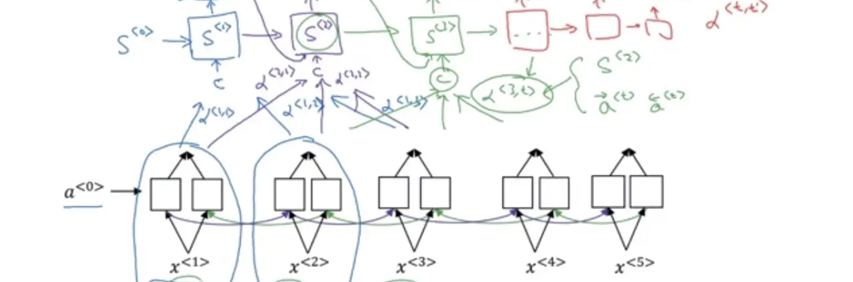
Overview: Attention Models
Attention Models Intuition
Attention models are neural networks that focus on specific aspects of a complex sequential input, one at a time until the entire dataset is categorized.

Slide 4
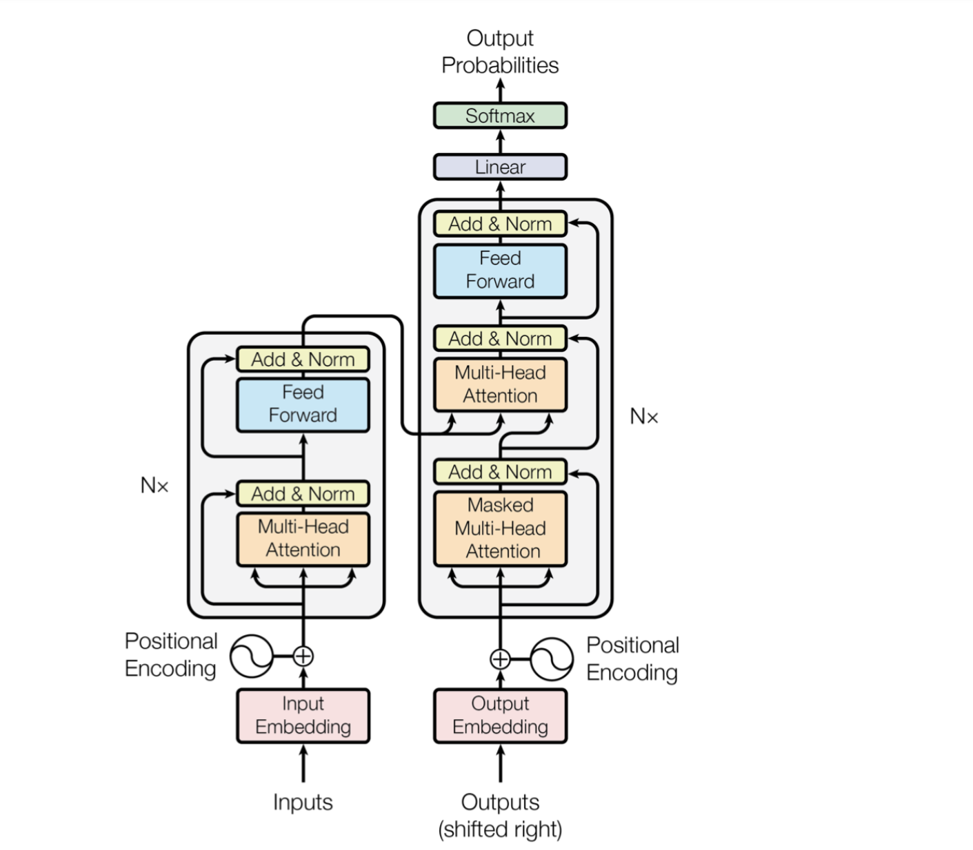
Overview: Transformers
The Transformer Neural Network is a neural network-based architecture that aims to solve sequence-to-sequence tasks while handling long-range dependencies with ease.
Used in image captioning, machine translation etc.
As shown in image, they have an encoder and decoder block.

Slide 5
How they work?
Take all input words/entire image at once, unlike the sequential approach of RNNs or attention models
Input image is then divided into smaller parts where these smaller parts need sequence information
Sequence information provided via positional embeddings. The output from positional embedding is fed into multiheaded attention layer in parallel. By parallel, we mean all image parts at once.

Slide 6
Multi headed attention computes self attention for each image part in parallel several times (heads) where each head could help the model learn a different contextual information
By self attention we mean creating the encoded representation of each image part in context of all other image parts
The output is then aggregated and normalized and passed through a feed forward layer

Slide 7
Then in decoder block, the output of previous sequence (image part) is fed to a multi headed attention layer
The output of which is then aggregated, normalized and given together with encoder block output to another multi headed attention layer
The output of that is then again aggregated, normalized and provided to a feed forward layer
Finally, a SoftMax layer is used to predict the caption for that image part (for example an image part may contain cat, while full image is cat playing with a ball)

Slide 8
Results Comparision
Let’s compare the BLEU scores achieved using Attention Model vs Transformers for the same image.
It helps to compare the generated image captions with the provided reference captions since multiple captions can be good
BLEU uses modified precision on n-grams in the generated image caption compared to the provided reference captions
BLEU also has an adjustment factor to penalize shorter image captions than the reference image caption
Maximum BLEU Score can be 100 (0-100)

Slide 9
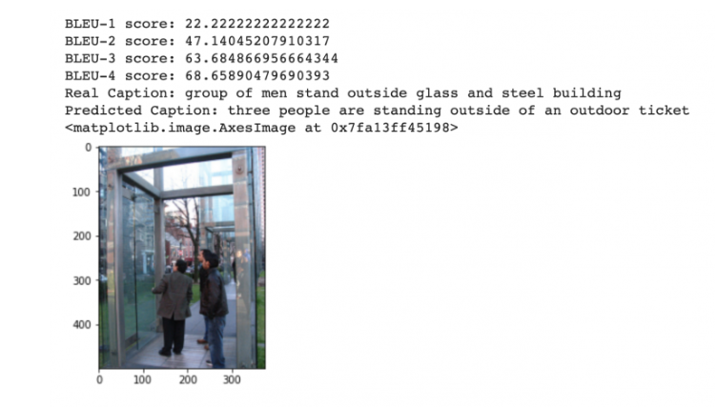
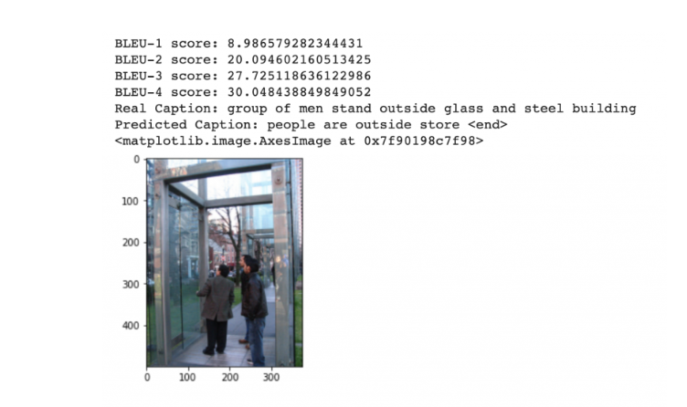
Results Comparision
Let’s compare the BLEU scores achieved using Attention Model vs Transformers for the same image.
Top picture is Transformer Model result while bottom one is Attention model.
Clearly Transformers result is better and has higher BLUE score (68.65 vs 30.04 of Attention Model)

Slide 10
Thank you

